Slide 1
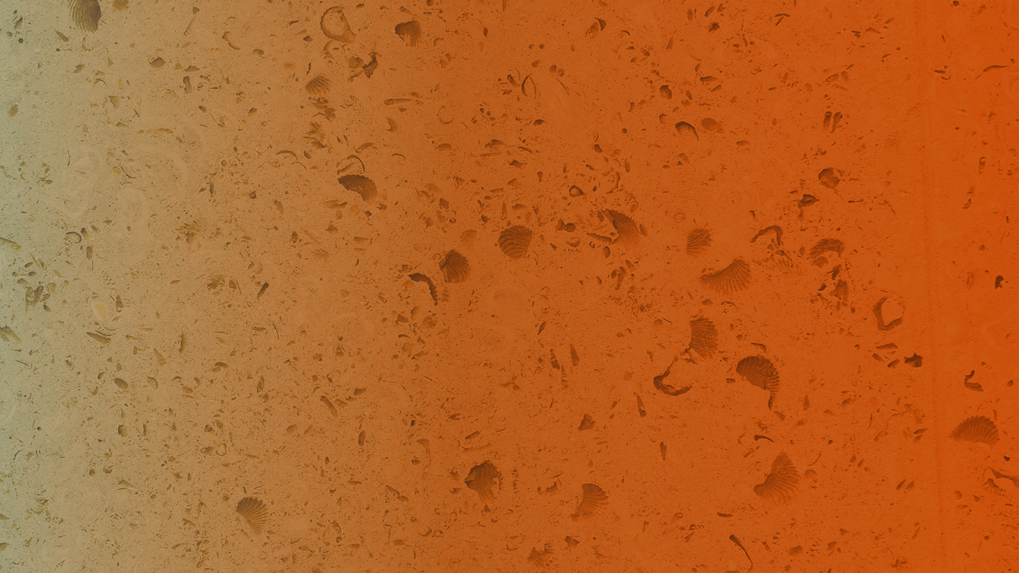

august 2020
Hidden Markov models
INS Bootcamp
marcel goldschen-ohm
Assistant Professor, The University of Texas at Austin

Slide 2
https://github.com/marcel-goldschen-ohm/INSBootcamp2020

Slide 3
PART 1
Overview of Hidden Markov Models (HMMs)
HMMs for ion channel gating
PART 2
Python & JupyterLab
HMM Simulation and Optimization in Python

Slide 4
Hidden Markov Models (HMMs)
Memoryless
Only care where we are,
not where we’ve been.
State A
State C
State B
Transitions
Rates per time interval
or probability per time step.
Notes:
Their dysfunction is related to disorders such as epilepsy, autism spectrum disorder, intellectual disability, schizophrenia, and neurodevelopmental disorders such as fragile X syndrome. Altered GABAAR expression is also a common feature of Alzheimer’s, Parkinson’s and Huntington’s disease.

Slide 5
Simple HMM for an Ion Channel
Open
Desensitized
Closed
Notes:
Their dysfunction is related to disorders such as epilepsy, autism spectrum disorder, intellectual disability, schizophrenia, and neurodevelopmental disorders such as fragile X syndrome. Altered GABAAR expression is also a common feature of Alzheimer’s, Parkinson’s and Huntington’s disease.

Slide 6
One possible state sequence (discrete time steps):
COOCODDDCOOCCDDDDDDCCODDDCOOOCODD…
Open
Desensitized
Closed
Notes:
Their dysfunction is related to disorders such as epilepsy, autism spectrum disorder, intellectual disability, schizophrenia, and neurodevelopmental disorders such as fragile X syndrome. Altered GABAAR expression is also a common feature of Alzheimer’s, Parkinson’s and Huntington’s disease.

Slide 7
Hidden States: Observed (pA):
COOCODDDCOOCCDDDDDDCCODDDCOOOCODD…
055050000550000000000500005550500…
5 pA
Open
Desensitized
0 pA
Closed
0 pA
Notes:
Their dysfunction is related to disorders such as epilepsy, autism spectrum disorder, intellectual disability, schizophrenia, and neurodevelopmental disorders such as fragile X syndrome. Altered GABAAR expression is also a common feature of Alzheimer’s, Parkinson’s and Huntington’s disease.

Slide 8
Hidden States: Observed (pA):
COOCODDDCOOCCDDDDDDCCODDDCOOOCODD…
054161001560001100100301014450610…
N(5,2) pA
Open
Desensitized
N(0,1) pA
Closed
N(0,1) pA
Notes:
Their dysfunction is related to disorders such as epilepsy, autism spectrum disorder, intellectual disability, schizophrenia, and neurodevelopmental disorders such as fragile X syndrome. Altered GABAAR expression is also a common feature of Alzheimer’s, Parkinson’s and Huntington’s disease.

Slide 9
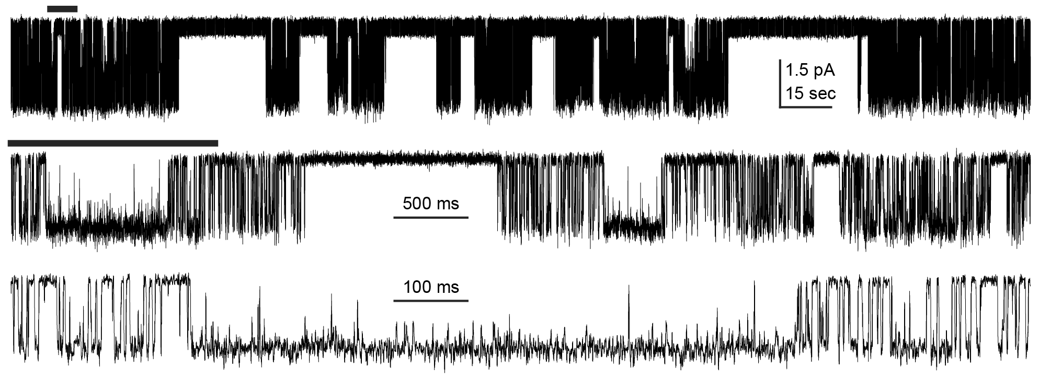
Can you guess how many closed and open states the channel visits (openings are downwards)?
Notes:
Their dysfunction is related to disorders such as epilepsy, autism spectrum disorder, intellectual disability, schizophrenia, and neurodevelopmental disorders such as fragile X syndrome. Altered GABAAR expression is also a common feature of Alzheimer’s, Parkinson’s and Huntington’s disease.

Slide 10
HMM
Simulation
Hidden States
COOCODDDCOOCCDDDDDDCCODDDCOOOCODD…
Observations
054161001560001100100301014450610…
Modeling
Notes:
Their dysfunction is related to disorders such as epilepsy, autism spectrum disorder, intellectual disability, schizophrenia, and neurodevelopmental disorders such as fragile X syndrome. Altered GABAAR expression is also a common feature of Alzheimer’s, Parkinson’s and Huntington’s disease.

Slide 11
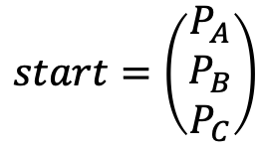
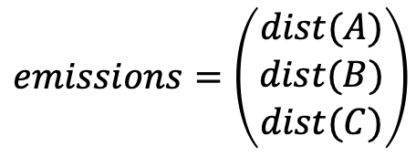
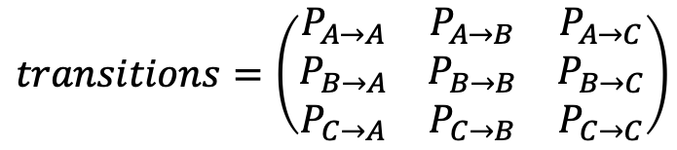
Parts of an HMM
$$start=\left(\begin{matrix}P_{A} \\ P_{B} \\ P_{C}\end{matrix}\right)$$
$$transitions=\left(\begin{matrix}P_{A→A} & P_{A→B} & P_{A→C} \\ P_{B→A} & P_{B→B} & P_{B→C} \\ P_{C→A} & P_{C→B} & P_{C→C}\end{matrix}\right)$$
$$emissions=\left(\begin{matrix}dist(A) \\ dist(B) \\ dist(C)\end{matrix}\right)$$
Notes:
Their dysfunction is related to disorders such as epilepsy, autism spectrum disorder, intellectual disability, schizophrenia, and neurodevelopmental disorders such as fragile X syndrome. Altered GABAAR expression is also a common feature of Alzheimer’s, Parkinson’s and Huntington’s disease.

Slide 12
PART 1
Overview of Hidden Markov Models (HMMs)
HMMs for ion channel gating
PART 2
Python & JupyterLab
HMM Simulation and Optimization in Python

Slide 13

Python & JupyterLab

